Slide 1
Week 3: Lab 3 - Urban Heat Island
Modified from: Lindsey Rodio
AOSC201 – Fall 18

Slide 2
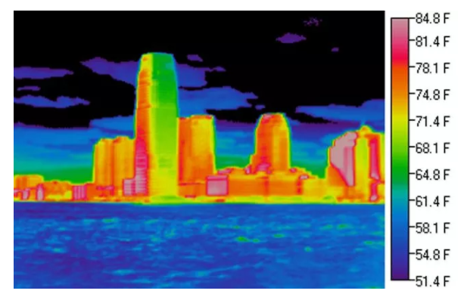
Urban Heat Island (UHI)
Metropolitan area that is warmer than its surroundings
City structure reduces air flow, traps heat
Example: city with a million residents
→ Mean air temperature: 1-3 °C warmer
→ Evening air temperature: 6-12 °C warmer
UHI effect on NYC skyscrapers
Notes:
Temp values come from USEPA

Slide 3
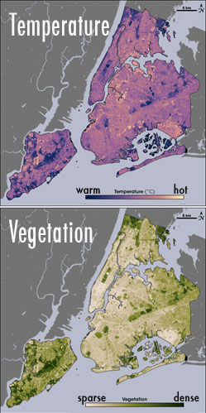
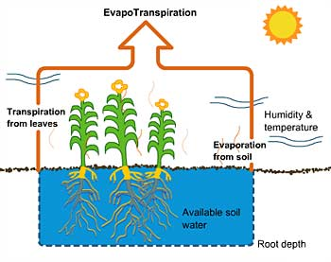
Urban Heat Island (UHI)
Formed from urbanization through paved roads, concrete structures, and reduced vegetation
Evapotranspiration – evaporation from soil and plants
“earth’s natural air conditioning”
Able to cool air 2-8°C
Evapotranspiration process
UHI effects in NYC
Notes:
Temperature and vegetation are highly correlated. Where vegetation is sparse, the temperature is hot. This is caused by evapotranspiration.

Slide 4
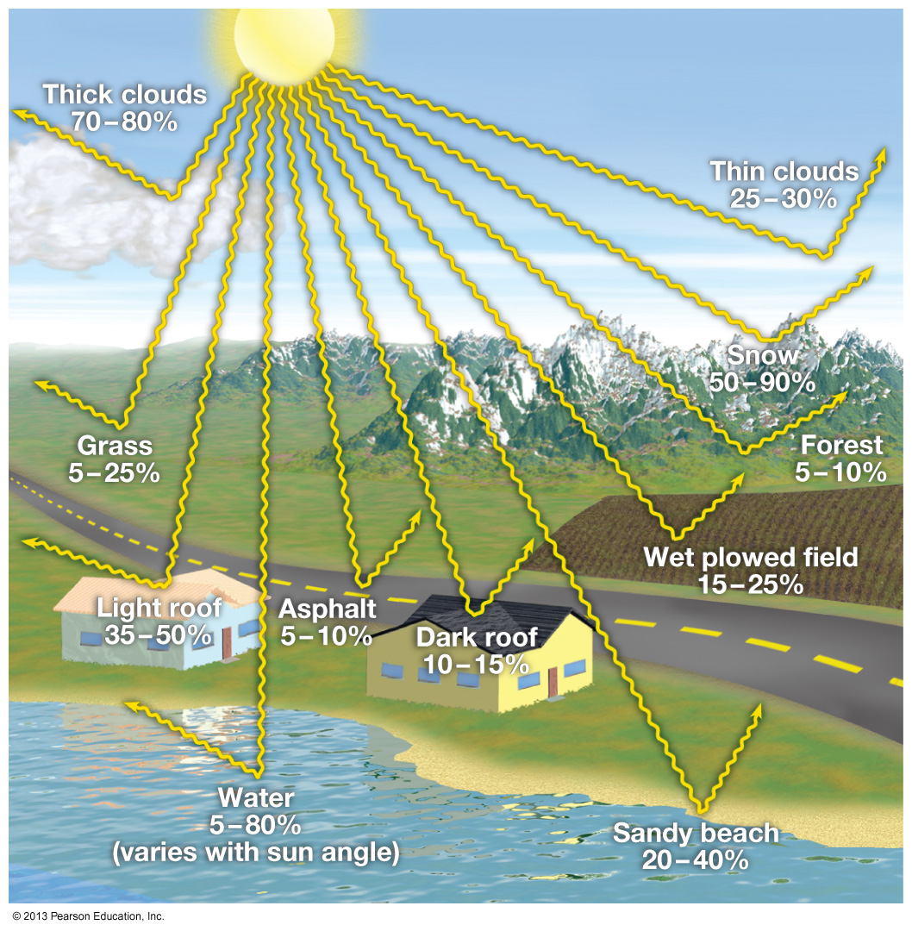
Albedo
Ratio of reflected solar radiation to the total incoming solar radiation
Higher albedo = higher reflectance
Urban areas absorb more insolation
→ Ambient temperatures rise
Some cities employ techniques to increase albedo
Use more reflective paints
→1997 study: surfaces with a white coating (α = 0.72) were 45°C cooler than black coatings (α = 0.08)
Planting trees, canopies, or green roofs
Grass: 5-25%
Asphalt: 5-10%
Dark roof: 10-15%
Light roof: 35-40%
Albedo of different surfaces
Notes:
Higher albedo surfaces can lower ambient air temp about 5C with conventional gravel surfaces

Slide 5
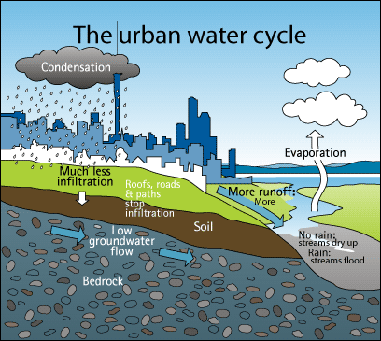
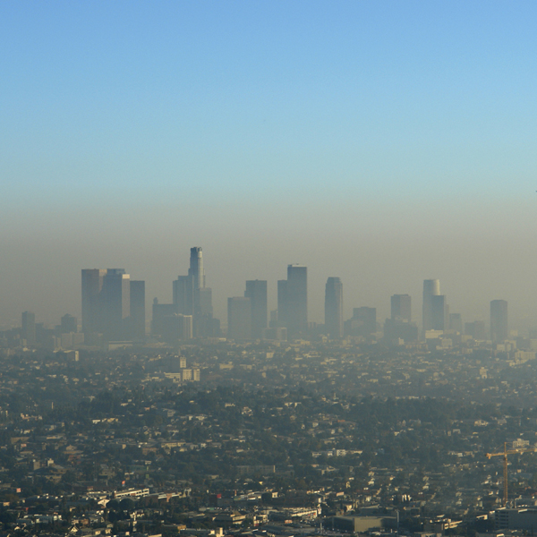
Urban Impacts
Cities with very little mitigation plans tend to exacerbate air pollution and flooding issues
Air pollution: hotter conditions means higher demand in energy use and could lead to higher rates of emissions/ozone formation
Flooding: impervious pavements disrupt the hydrologic cycle
Notes:
River incision is the narrow erosion caused by a river or stream that is far from its base level

Slide 6
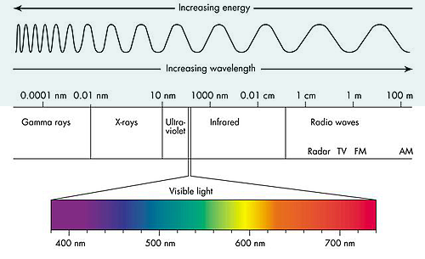
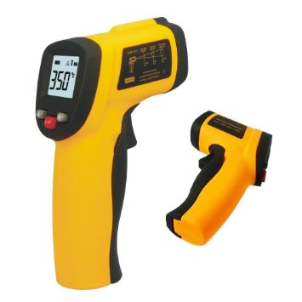
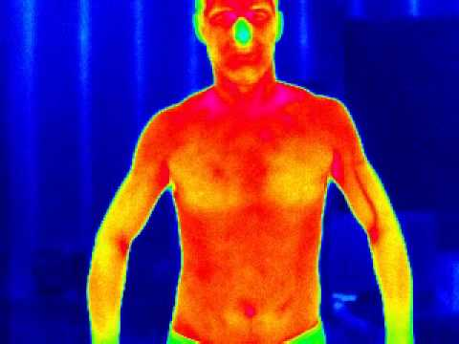
Importance of Infrared (IR) Sensors
Just like IR satellite channels!
Measures the temperature of a surface
Surfaces emit energy in the infrared that is dependent on its temperature
Example: warmer colors represent warmer parts of the body (enhanced image)
To measure: just point at anything and press the button!
Don’t try to point the sensor directly at someone's eye… just don’t do it
Notes:
River incision is the narrow erosion caused by a river or stream that is far from its base level

Slide 7
So… what about wet surfaces?
But first… what is heat capacity?
a measurable physical quantity equal to the ratio of the heat added to (or removed from) an object to the resulting temperature change
Water heat capacity: 4185.5 J kg⁻¹K⁻¹
Air heat capacity (at a constant pressure): 1004 J kg⁻¹K⁻¹
Questions to ask yourself: What do these different values represent?
How do these mediums hold heat?
How do these values affect temperatures of that medium?
SPLIT INTO GROUPS OF 2 ONLY TO TAKE MEASUREMENTS FOR THIS LAB!!!
Notes:
River incision is the narrow erosion caused by a river or stream that is far from its base level

